Slide 1
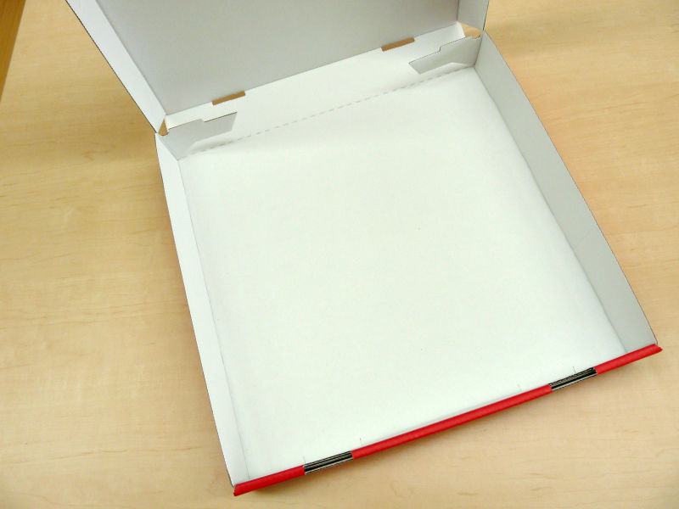
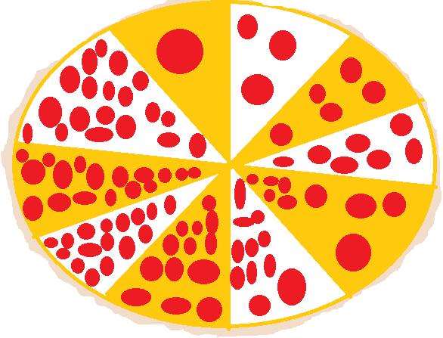
Geometric Sequence
2(2)^1-1=2
2(2)^2-1=4
2(2)^3-1=8
2(2)^4-1=16
2(2)^5-1=32
PIZZA & MARINARA SAUCE
The table with the red dots
Hypothetically display the marinara sauce
As well as represent the geometric sequence
by accurately displaying the quantity
of sauce up until the 5th term.
KATIE HUNT
09/14/12
50th block
<Formula: 2(2)^n-1
1
2
3
4
5
Arithmetic Sequence
2(1)-1= 1 | 2(6)-1=11
2(2)-1=3 | 2(7)-1=13
2(3)-1=5 | 2(8)-1=15
2(4)-1=7 | 2(9)-1=17
2(5)-1=9 | 2(10)-1=19
The pizza with the one pepperoni,
starts our display going clockwise, to exhibit
The increase in pepperonis by 2 to
demonstrate the arithmetic sequence .
<Formula2(n)-1

